Slide 1
Resolution to Support Medicare For All
Presented by medical students & Kent residents:
Max Brockwell
James Moore
Michael Massey
Notes:
Hello, thank you for this opportunity to present on and introduce our resolution to support Medicare For All. We have a lot of slides that we really wanted to touch on, and I know we have 10 minutes, so we are going to try and go quickly, feel free to interrupt us if our time runs out.

Slide 2
Coming Up: Part One
State of affairs in the US healthcare system
Effects of our broken system
The solution: Improved Medicare For All!
The opposition & mythbusting counter-arguments
Summary & a call to action!
Part One→
Part Two
Part Three
Notes:
To start off, we will be covering some of the problems in our health insurance system that Medicare For All will able to address. Then we will emphasize the importance of and describe the 2022 Medicare for All Senate Bill. Finally, we will lightly touch on the opposition to Medicare For All and address some of the common, misplaced fears of the policy.

Slide 3
Part One: State of Affairs of US Healthcare & it’s effects on Americans
State of affairs in the US healthcare system
Record-high rising costs on healthcare spending
What does that money actually get us?
Effects of our broken system
Financial Hardship
Delayed Care
Unnecessary Death
Notes:
For Part One, we want to emphasize that right now, the US spends more per capita on healthcare than any other country and STILL gets far worse health outcomes. Also this predatory “health care for those who can afford it” system causes financial hardship, avoidance of care, and unnecessary death for Americans.

Slide 4
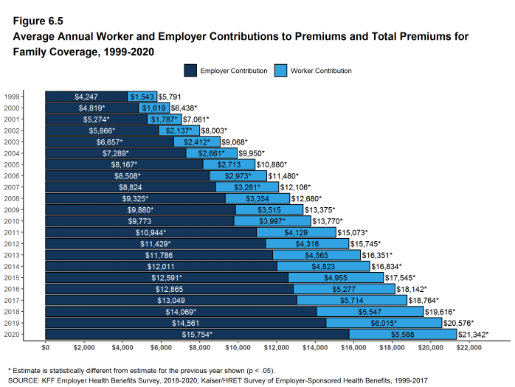
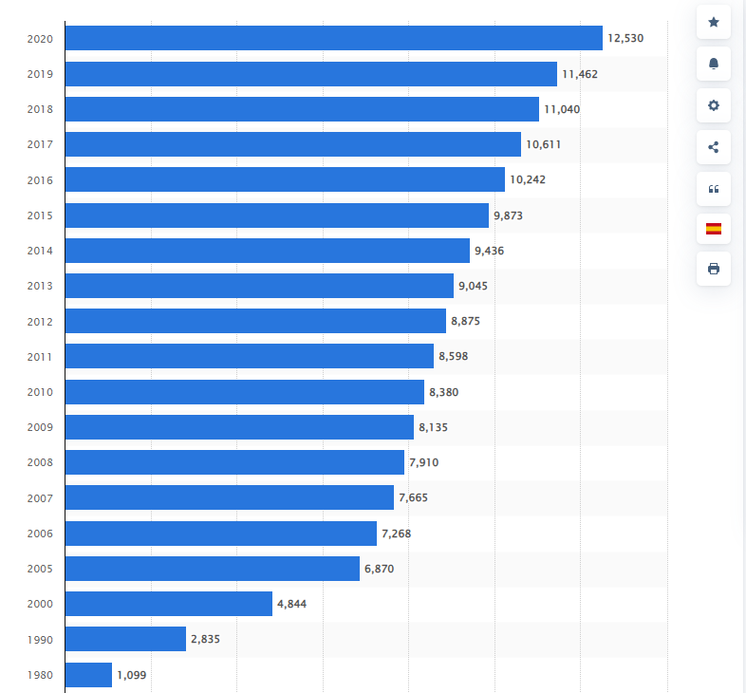
State of affairs in the United States healthcare system
National per capita health expenditure in the United States from 1980 to 2020
Record-high healthcare spending and employee contribution to premiums
Notes:
Currently, the US spends more money on healthcare than many other countries with universal healthcare systems. As you can see in the chart, the US’s national per capita health expenditure has continually increased–there is record high spending.
As you can see on the figure on the right there is also a continual increase in the average worker and employer contributions to premiums.
Not so much important how we spend as a country, but it’s important to people how it affects them…
Annual premiums for family of 4 increasing over decades in 2020 total was $21,000, worker contribution increasing

Slide 5
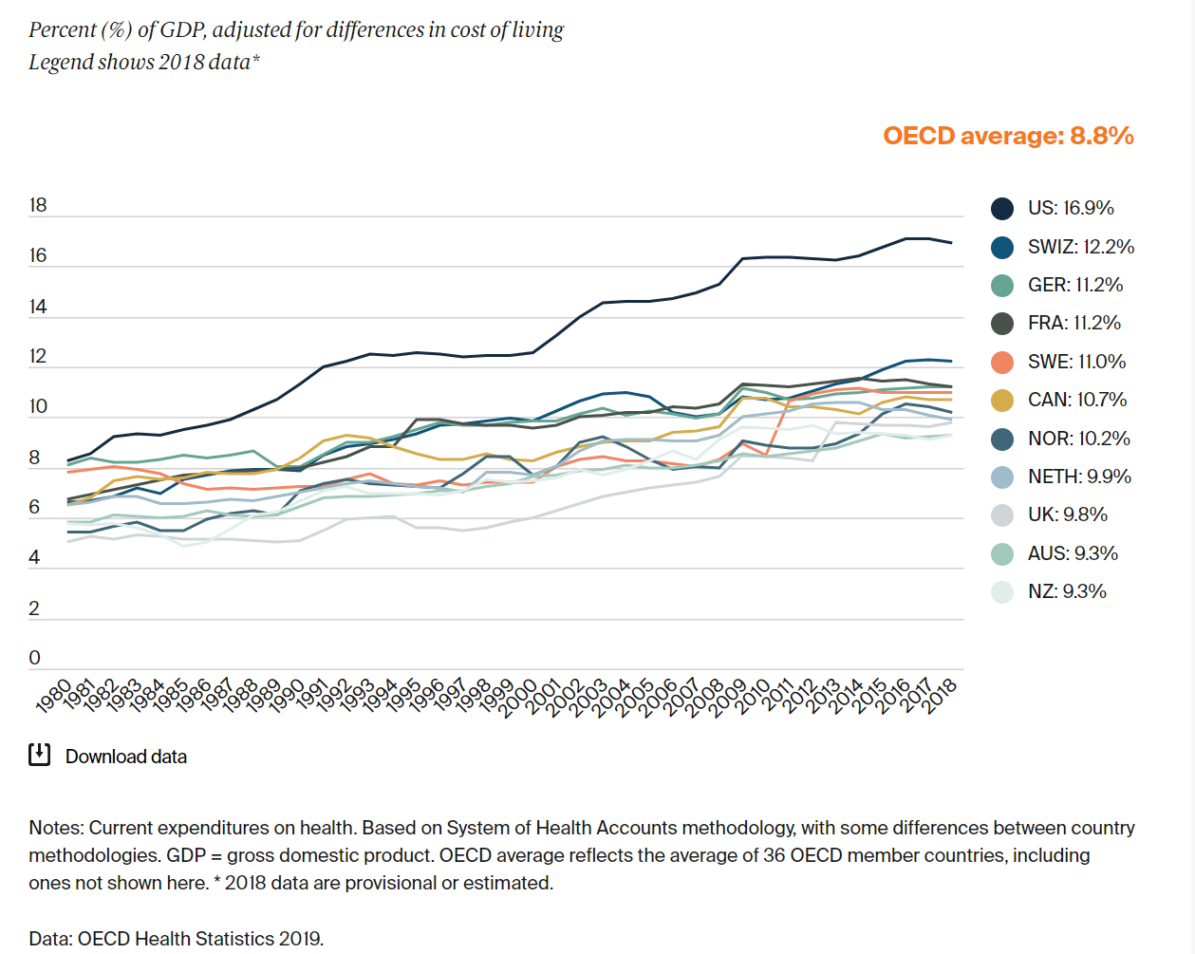
State of affairs in the United States healthcare system
The US spends more money on healthcare than many other countries with universal healthcare systems
Notes:
Additionally, the US spends more money on healthcare than many other countries with universal healthcare systems. The last data point was in 2018 when the US was spending 16.9% of its GDP on healthcare, but the latest data suggests that number has increased to 19%.
So you might think that more spending is better health right? Well you’d be wrong!

Slide 6
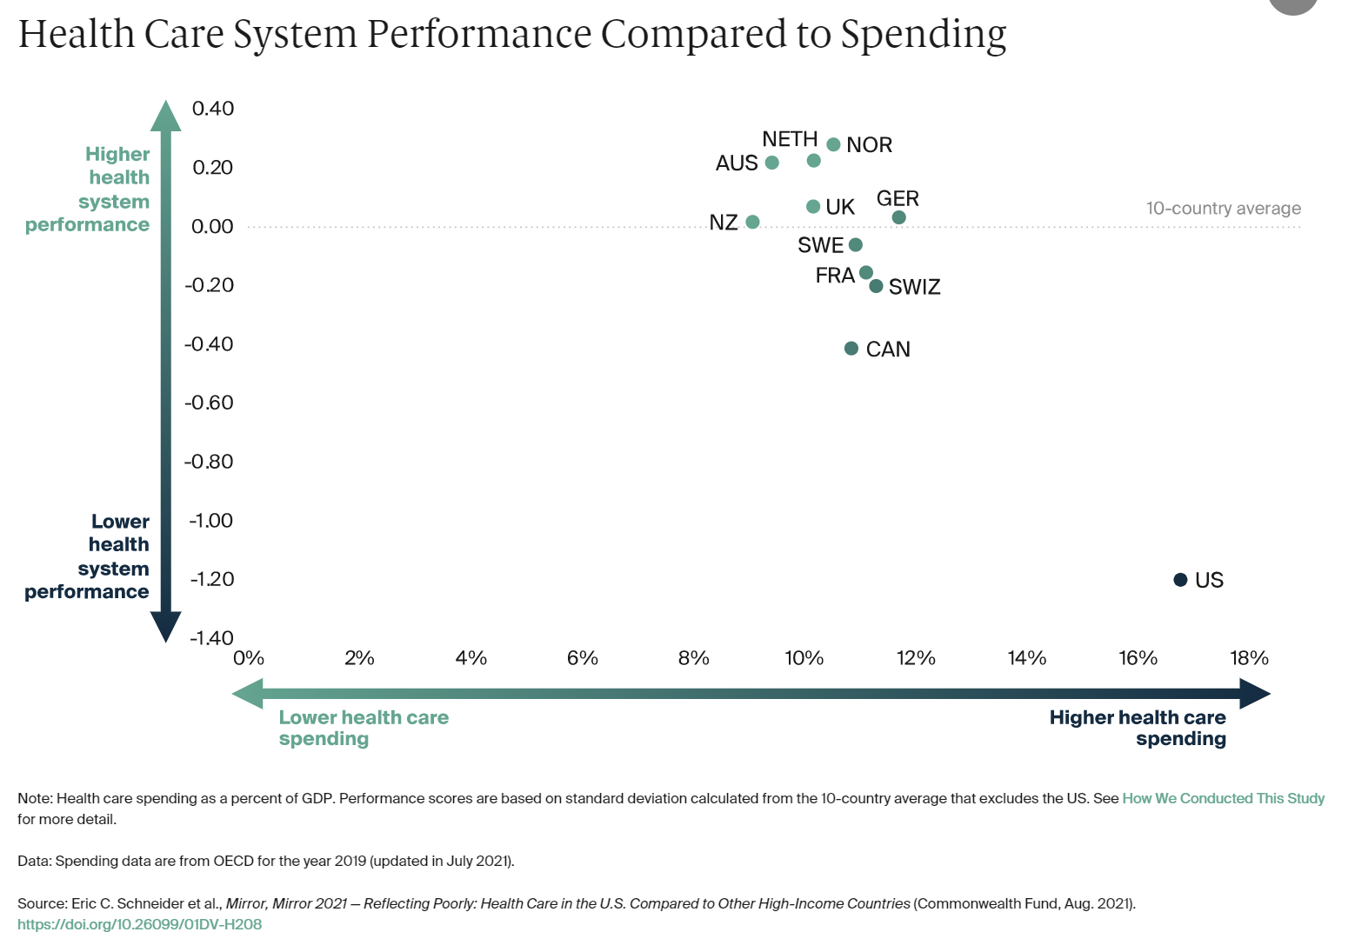
What does that money get us?
Notes:
As you can see, we spend significantly more but significantly performed worse. This is from the 2021 Commonwealth study, where US ranked 11 out of 11 in a comprehensive assessment of healthcare systems compared to other OECD nations.
There are several studies now that all show the US ranks very low on healthcare, while spending way too much per capita.

Slide 7
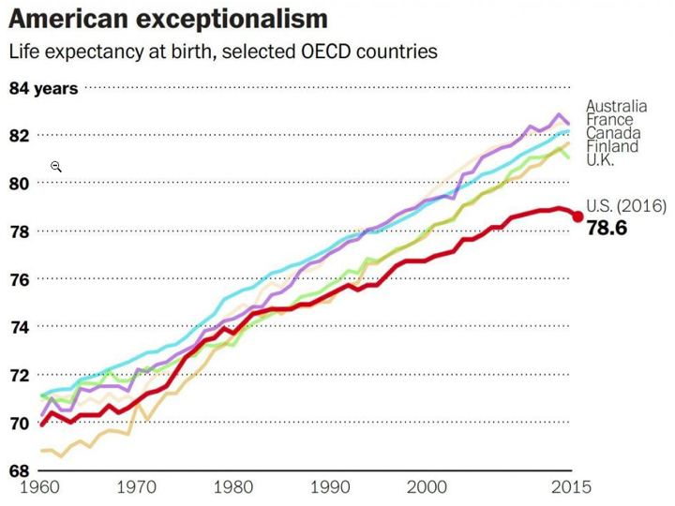
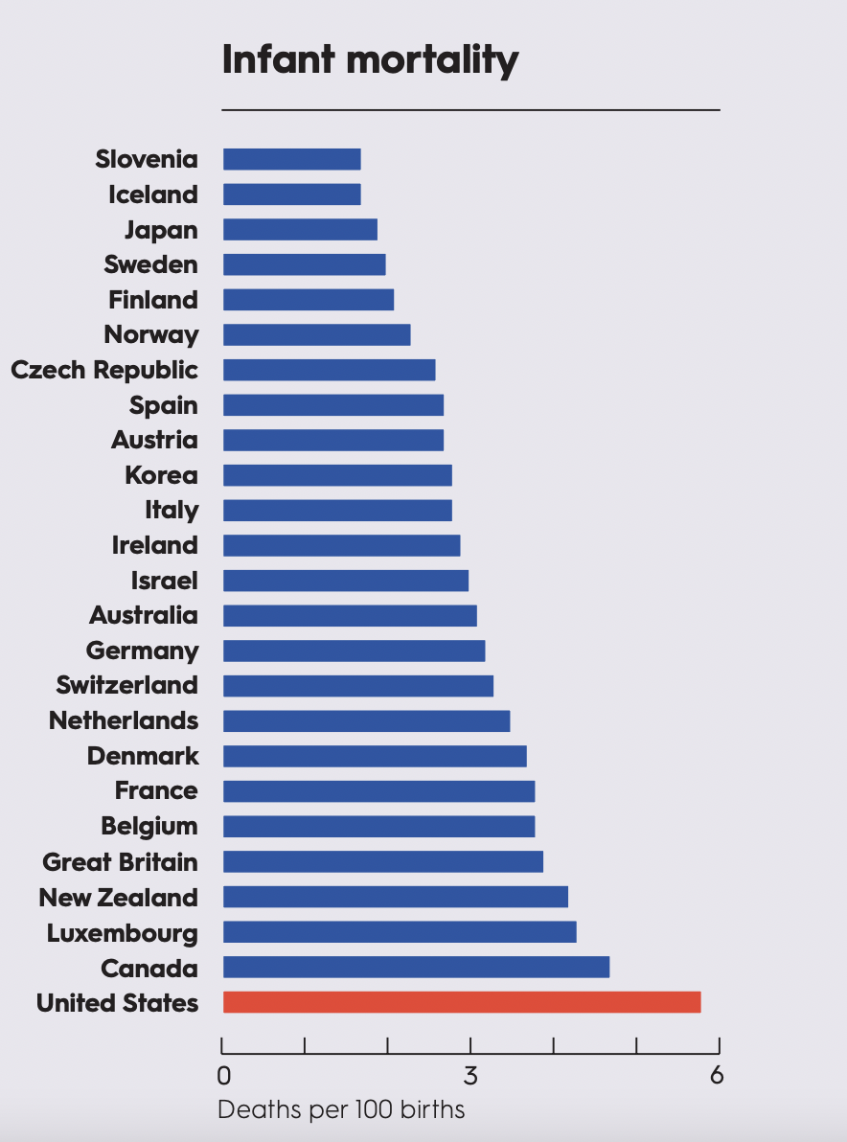
What does that money get us?
OECD (2019), Health at a Glance 2019: OECD Indicators
Decreasing life expectancy and increased infant mortality in the US
Notes:
To get into the commonwealth study’s findings: 1. Life expectancy is one of the lowest compared to other OECD countries.
Additionally, infant mortality is one of the highest compared to other OECD countries.

Slide 8
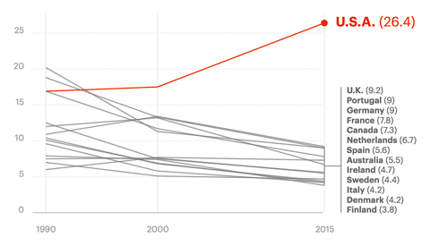
What does that money get us?
Maternal Deaths per 100,000 live births
Maternal mortality is rising in the US but decreasing in other countries
Notes:
In addition, maternal mortality is not only the highest compared to OECD, but we are the only country where Maternal Mortality is RISING over the past 22 years..

Slide 9
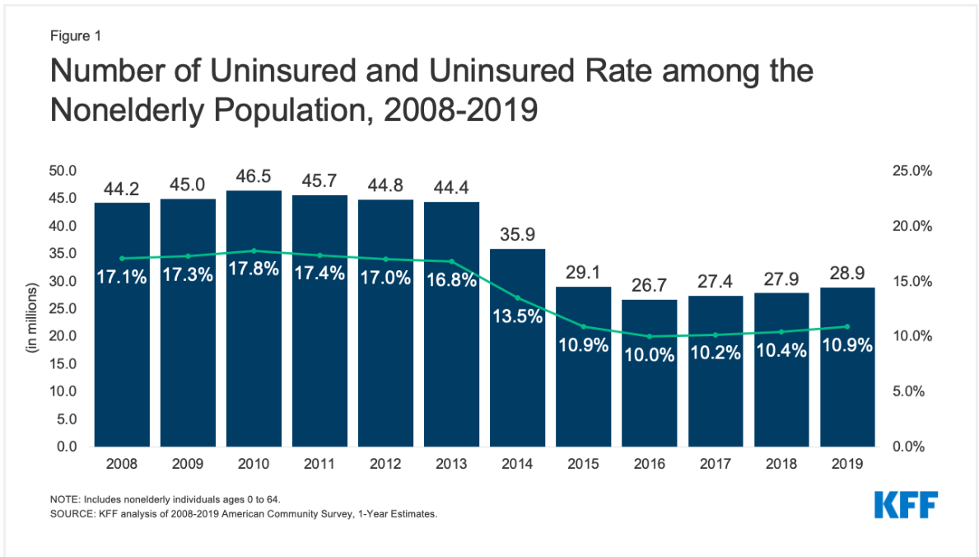
What does that money get us?
Notes:
Even though the ACA set out to address the high uninsured population, it did not go far enough. 27 million people were still uninsured in 2016, when the ACA had it’s strongest effects on uninsurance rates.
This number has continued to rise, especially during the COVID-19 pandemic –a time when people needed health insurance the most.

Slide 10
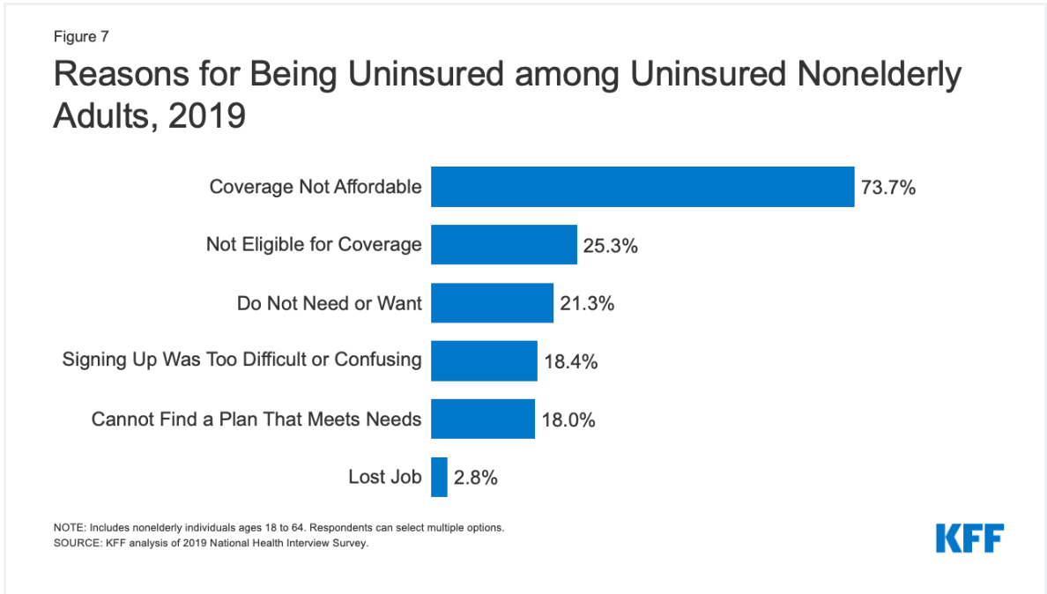
What does that money get us?
Notes:
Just to solidify our argument here, in the Kaiser Family Foundation study from the previous study, Americans emphasized in a national survey that COST is the biggest barrier to buying into an insurance plan, even on the ACA exchange market.

Slide 11
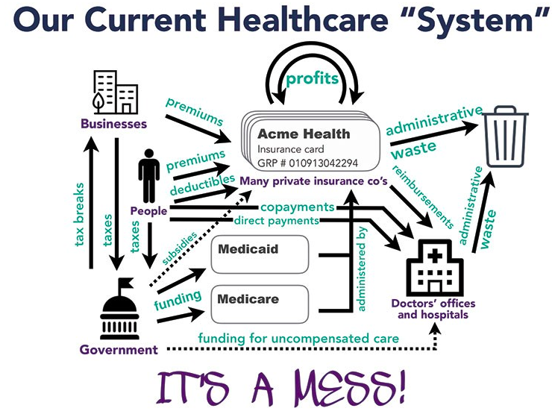
Why is our system so broken?
Source: PNHP-NY Metro and Campaign for NY Health
Notes:
So why is all of this happening? To put it simply, our healthcare system is unnecessarily complicated, with money changing hands far too much between far too many stakeholders.
Each of these private equity and private health insurance companies are designed to profit off of health care like a business, which raises costs & increases administrative waste, while putting a barrier up between patients and their doctors.

Slide 12
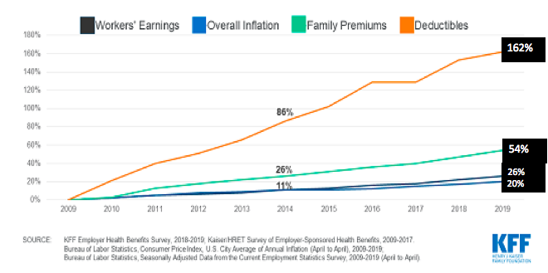
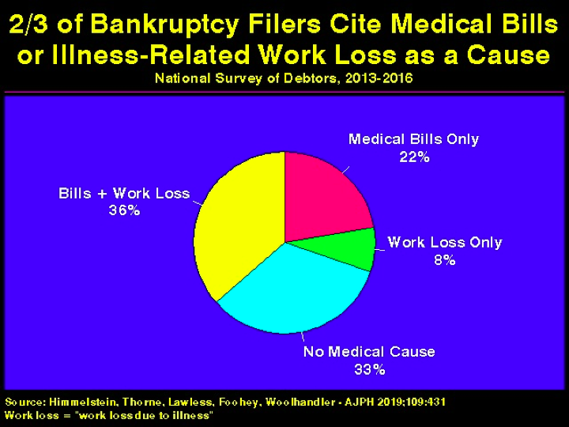
Effects of our broken system: Financial Hardship
Notes:
So how does our hyperinflated healthcare costs affect everyday people, well for people who get diagnosed with a chronic illness or need an expensive procedure to save their life, they often have to go bankrupt if they are un- or under-insured.
To explain what we mean by “underinsurance”-> “Underinsurance” is when someone has health insurance, but their insurance provider does not cover all the medically necessary procedures they will end up seeking, or the insurance company demands the patient to pay enormous sums of money in the form of a deductible, before the insurance company will begin to pay for coverage themselves.
Deductible pay rates have skyrocketed over the past 13 years by over 162%, so patients barely get any support on their first thousands of dollars of medical bills from the insurance company. As a result, ⅔ of bankruptcy is due to medical debt. Medical debt is the highest cause of bankruptcy in the US!

Slide 13
Effects of our broken system: Delayed Care
Notes:
In relation to the large financial hardship caused by high costs in our system, high costs also cause delayed care and worse health for our country. Even modest co-pays and any barrier to accessing care can deter patients from seeking life saving treatments
Both graphs show how much more likely people were to delay or completely forfeit seeking the next step in treatment if they were in a high-deductible plan versus a low deductible plan.
All income groups saw significant periods of delay in treating their breast cancer if their deductible plans were high, and diabetic patients with poor insurance delay or forfeit seeking care, leading to massive complications and progression of their diabetes.
As a foreshadow, Medicare For All would completely remove deductibles and copayments, completely removing this health disparity.

Slide 14
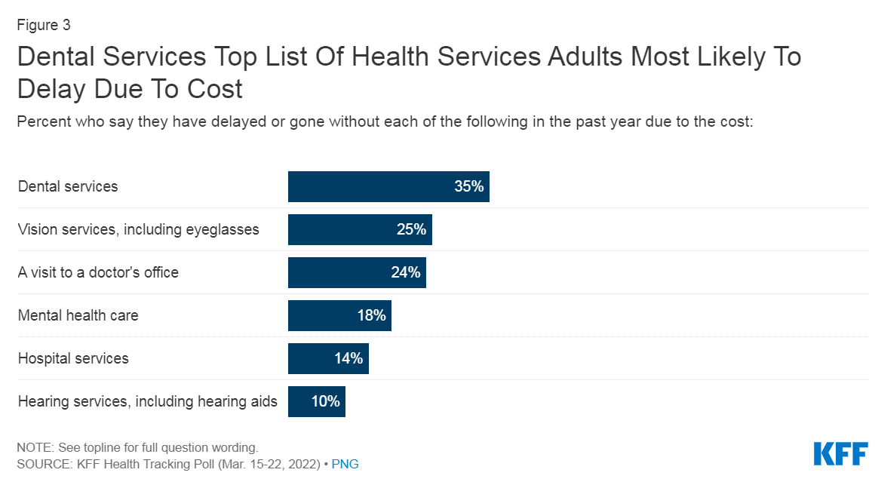
Effects of our broken system: Delayed Care
Notes:
This figure shows which health services are most likely to be avoided due to costs. Dental, vision, mental health care, and hearing aids are all the least likely services to be covered under traditional services, and not covered well under Medicare currently.
As a foreshadow, Medicare For All would completely cover all of these services, finally addressing the needs of millions of Americans.

Slide 15
Effects of our broken system: Delayed Care
Notes:
For many U.S. adults, prescription drugs are another component of their routine care. Among those currently taking prescription drugs, one in four say they have difficulty affording their cost, including about one third who take four or more prescription drugs (33%).
The high cost of prescription drugs also leads some people to cut back on their medications in various ways or to try to obtain medications outside of a clinical setting. About a quarter (23%) of adults say they or family member in their household have not filled a prescription, cut pills in half, or skipped doses of medicine in the last year because of the cost.

Slide 16
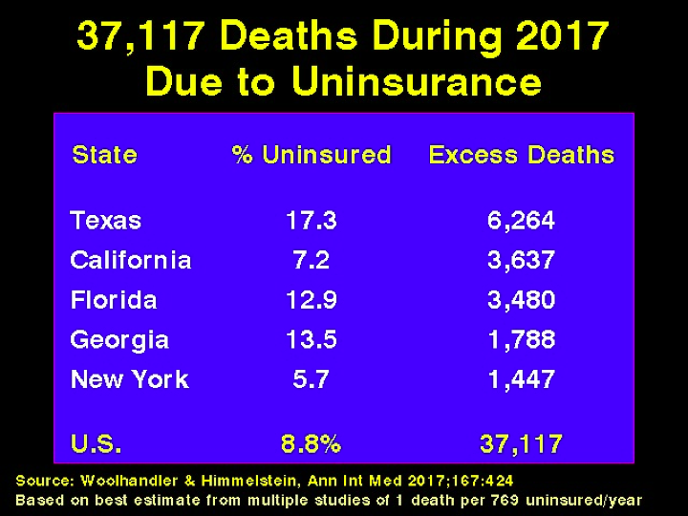
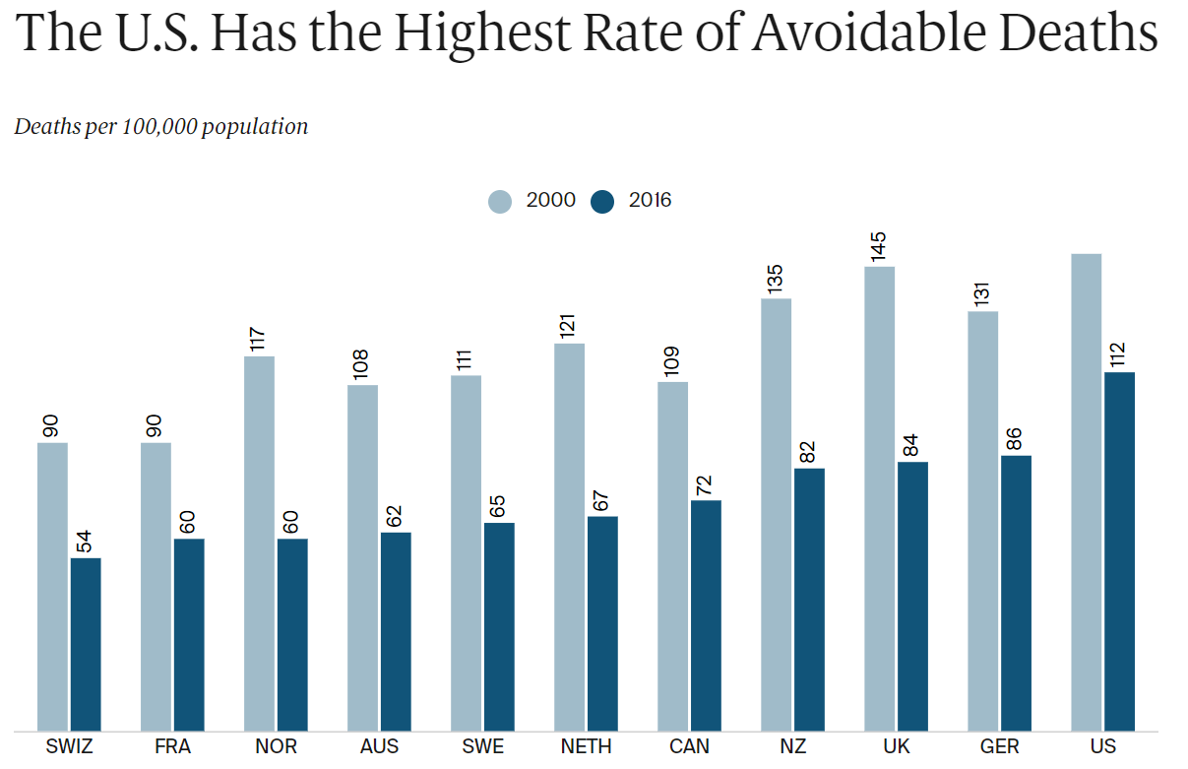
Effects of our broken system: Unnecessary Death
Notes:
So what does all of the previous data and health disparities we discussed lead to? Unfortunately, which many of you may be aware of already, this leads to untimely and early death.
Death attributable to a lack of insurance is a measurable, strong correlation, with tons of news stories highlighting people who rationed their insulin or put off going to the ER with a severe headache due to the fear of costs and then dying without proper treatment.

Slide 17
Coming Up: Part Two
State of affairs in the US healthcare system
Effects of our broken system
The solution: Improved Medicare For All!
The opposition & mythbusting counter-arguments
Summary & a call to action!
Part One
Part Two →
Part Three
Notes:
So those are the issues with our current system, now let’s move onto the 2022 Medicare For All Senate Bill, and how it addresses the issues we just laid out.

Slide 18
Part Two: The solution- Improved Medicare For All
Compare and Contrast Single Payer to Other Proposals
Emphasize the Importance of Single Payer
Outline of the Bill, Brief Look into the Entire Policy
Summary - Highlights of the Bill
Notes:
For Part Two, we will start by comparing Medicare For All to other half-measure proposals, like a Public Option expanding the ACA, and emphasize the importance of implementing a full “Single Payer” or Medicare For All System
Next, we will present a brief outline of the Medicare For All bill
Then, we will summarize the bill’s major takeaways.

Slide 19
Comparing the Different Healthcare Proposals
Bernie Sanders’ & Pramila Jayapal’s bills are the only proposals that:
Expands Medicare to cover all services
Others neglect vision/dental/mental/long-term care
If these services are left uncovered, patient health suffers
Eliminates all out-of-pocket expenses
Others keep some or all out-of-pocket expenses (premiums, etc.)
Currently, Medicare only covers 80% of costs→ Still penalizes seeking care
Is truly universal, everyone gets this expanded Medicare plan
Others keep private health insurance in place for much longer, or permanently
Keeping a fractured payment system is one of the leading reasons for wasteful administrative spending in the US
Notes:
SNaHP and PNHP support the Bernie Sanders’ & Pramila Jayapal’s bills, because they are the only plans that satisfy each of the following criteria.
They expand Medicare to cover all medically necessary services, where other plans will leave these essential services to either be covered by private insurance or out-of-pocket expenses.
They eliminate all out-of-pocket expenses (except for a potential for some expenses on prescription drugs), while other plans keep a lot more out-of-pocket expenses within Medicare, Medicaid, or Private Insurance
They are truly universal: meaning everyone is granted coverage under this plan, and no one has to navigate the fractured and hyper-inflated private health insurance market

Slide 20
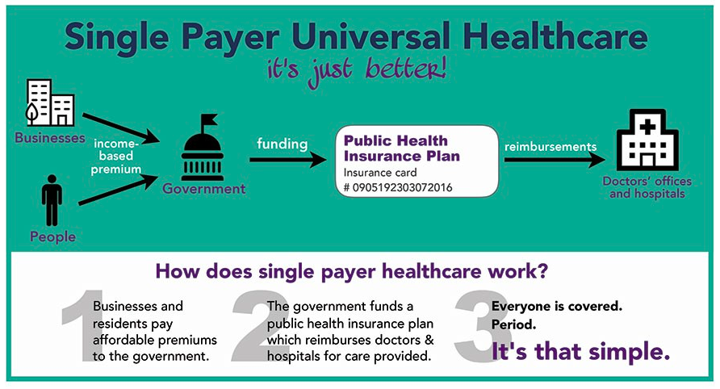
2. The Importance of a Comprehensive, SINGLE-payer system
Notes:
While Medicare For All is pretty well known at this point, I did want to include this slide just to help define what we mean by “Single Payer”. “Single Payer” just means that the government is the sole provider, the singular payer, of health insurance in the country.
In these plans, a wall street transaction tax, payroll tax on businesses, and a progressively structured income tax, where the vast, VAST majority of americans save thousands of dollars compared to their current healthcare expenditures→ ALL GO TO funding this Public Health Insurance Plan
And this public health insurance, send payments and reimbursements to PRIVATELY owned doctor’s offices and hospitals. So the claim that medicare for all makes physicians and other health care providers government employees is not accurate.

Slide 21
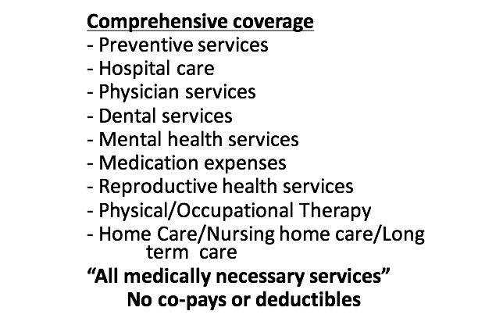
(2.) Improved and Expanded Medicare for All
Notes:
When we mentioned that Medicare for All would cover all medically necessary services, these are what we are referring to, all covered without copayments or deductibles

Slide 22
(2.) Improved and Expanded Medicare for All
Economic Side
Funded by progressive taxes based on ability to pay and modest taxes on Wall Street
Provides immense administrative savings (estimated ~$500 billion annually)
Eliminates patient out of pocket expenses (co-pays, premiums, deductibles)
Allows for more bargaining power for lower drug prices
Notes:
There are also many economic upsides to single-payer. First it has a more progressive funding stream than our current system, since:
Funded by progressive taxes based on ability to pay and modest taxes on Wall Street
Next, the streamlined structure will provide immense administrative burden which the private insurance industry imposes
Next, we will be able to make healthcare affordable and cost predictable for every patient by eliminating out of pocket cost
In addition, by having a single payer, we will be able to negotiate lower prices on drugs through increased bargaining power.

Slide 23
3. What is actually in the new Med-For-All Bill? (Outline)
TITLE I- Establishment of the Medicare For All Program; Universal Entitlement to Benefits; Enrollment
TITLE II- Comprehensive Benefits, Including Benefits for Long-Term Care
TITLE III- Provider Participation
TITLE IV- Administration
TITLE V- Quality of Care
TITLE VI- National Health Budget; Provider Payments; Cost Containing Measures
TITLE VII- Universal Medicare Trust Fund
TITLE VIII- Conforming Amendments to the Employee Retirement Income Security Act of 1974
TITLE IX- Additional Conforming Amendments
TITLE X- Transition to Medicare for All
TITLE XI- Miscellaneous
Notes:
Here is the outline of the bill, in our previous presentations that this abbreviated presentation was based upon, we actually broke down every TITLE in the bill, and we be happy answer any questions in a Q&A portion at the end, but we will just summarize the key points in the next slide…

Slide 24
4. Summary - The 2022 Medicare for All Act
Implements universal, comprehensive healthcare coverage with a 4-year rollout plan
Automatically enrolls children and newborns into program
Creates a temporary Medicare-Buy-In and Public Option program
Improves Medicare for the 4-year transition period by:
Caps out-of-pocket expenses: $1,500 Co-Insurance, $305 Prescription, $0 Deductibles
Improves access: Dental/Vision/Hearing Services & Enrolls people w/ disabilities
Provides 5 years of complete worker assistance to health insurance workers
Drastically reduces out-of-pocket expenses for patients
Eliminates Co-Payments, Co-Insurance, Premiums, and Deductibles
$200 cap for out-of-pocket payments on prescription drugs
Covers all medically necessary procedures w/ an appeal process for experimental ones
Moves Medicare for All physician/institution payment rates out of congress, and into the executive branch, specifically Regional Directors, who work with physician panels
Notes:
(TO SUMMARIZE- READ OFF SLIDE)

Slide 25
Coming Up: Part Three
State of affairs in the US healthcare system
Effects of our broken system
The solution: Improved Medicare For All!
The opposition & mythbusting counter-arguments
Summary & a call to action!
Part One
Part Two
Part Three →
Notes:
Now that we have highlighted the benefits of the bill, let’s take the last portion of our presentation to address the opposition to Medicare For All and some of the most common talking points against Medicare For All.

Slide 26
Part Three: Addressing the Opposition & Summary
Identify the Most Influential Opposers of Medicare for All
Mythbusting Counter-Arguments: Red-Scare and Economics
Mythbusting Counter-Arguments: Operational Critiques
Mythbusting Counter-Arguments: Half-measure Plans
Summary & Closing Arguments
A Call to Action!
Notes:
For Part Three: We are going to discuss some of the most powerful opposers of Medicare For All to understand why they oppose any changes to healthcare.
Then we are going to move into our Mythbusters section of the presentation, where we will be presenting a common critique or fear of Medicare For All at the top of each slide, and then break down how those counter arguments are either misguided, or completely made in bad faith to smear this policy.

Slide 27
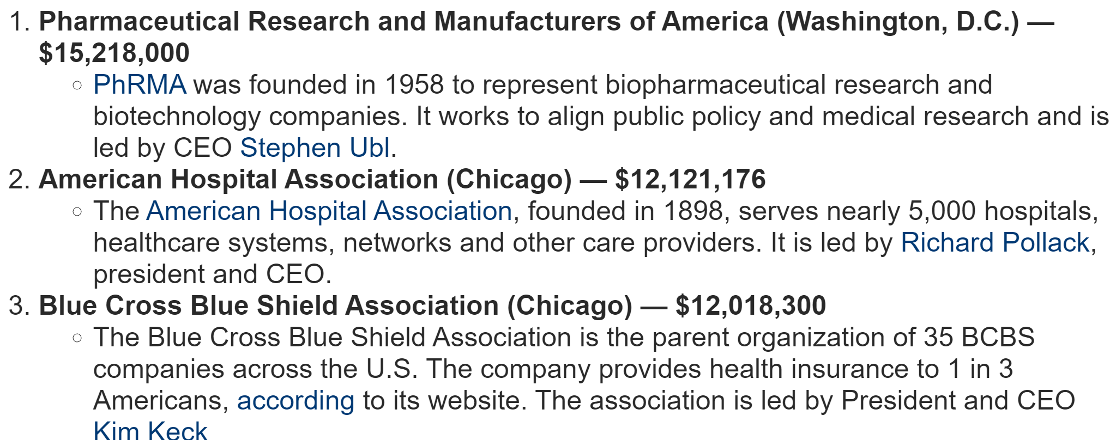
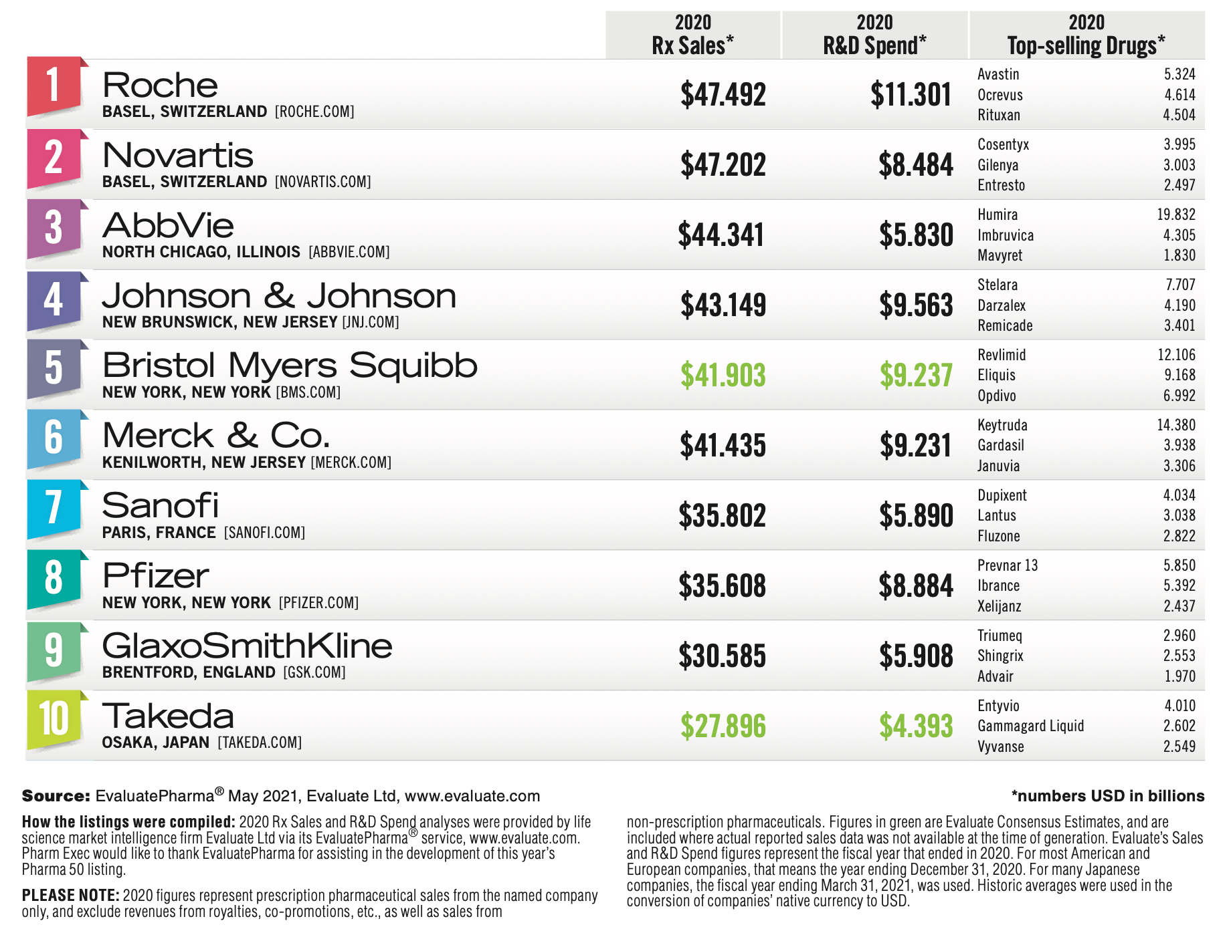
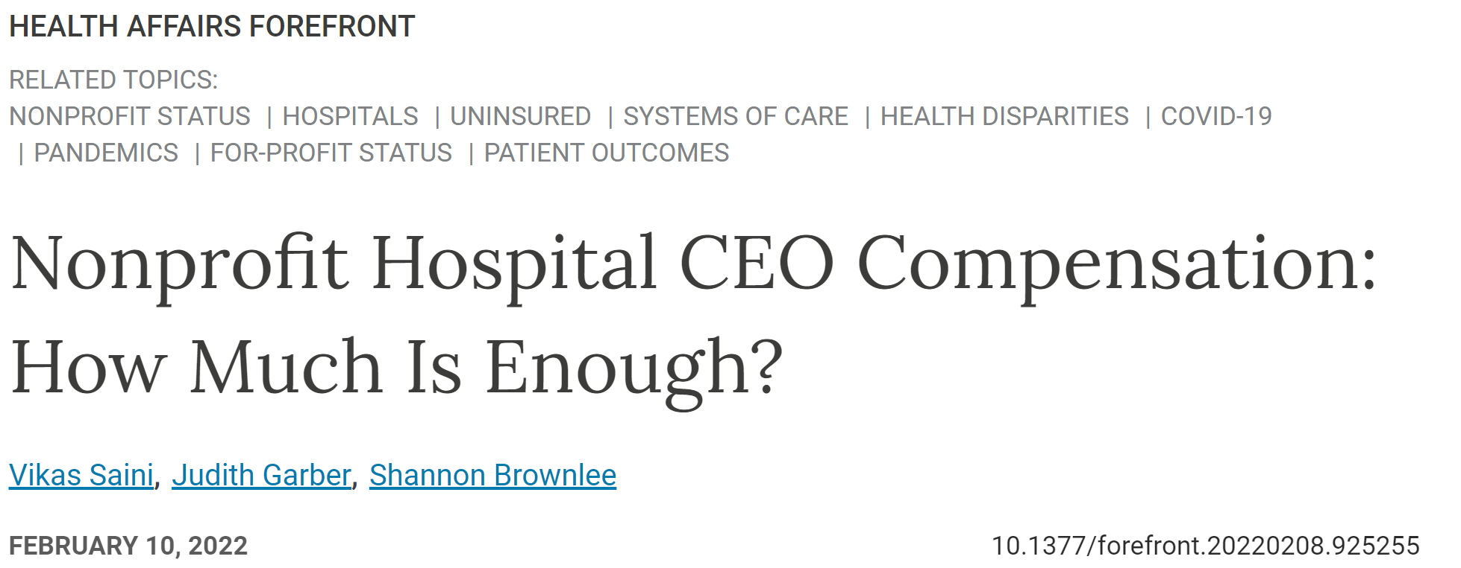
Identify the Most Influential Opposers of Medicare for All
There is a lot of money to be made in price- gouging pharmaceuticals and denying coverage
Notes:
Before we start addressing each of the most salient anti-Med4All talking points, we wanted to first give a brief insight into the powers at be who are crafting these counter arguments for members of the media to regurgitate. That may sound hyperbolic, but every major news station does bring on panelists who are on the boards of these companies or work for a think tank who is funded by these interests.
The information on the top-right of the screen shows how much money, in the BILLIONS, that pharmaceutical companies earn in profits in comparison to how much they spend on Research & Development.
CEO compensation for even Non-Profit Hospitals is higher than it has ever been, and the top-left and bottom-right images show what lobbying groups spend the most money in campaign contributions.
In short, there is a lot of money to be made when you can price gouge the American People on pharmaceuticals, and when an insurance monopoly can deny coverage at whim to increase their profit margins

Slide 28
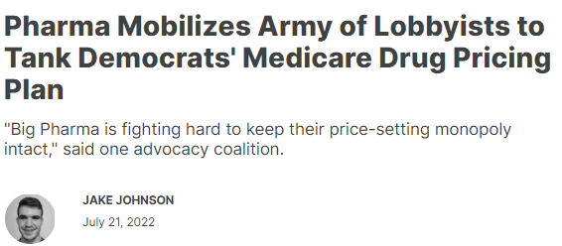
The Power of Lobbying Against Health Care Expansion Efforts
Pharmaceutical Lobbyists Prevented Medicare Part D from Negotiating Drug Prices in the 2003 Medicare Modernization Act
“The pharmaceutical lobbyists wrote the bill,” says Jones. “The bill was over 1,000 pages. And it got to the members of the House that morning, and we voted for it at about 3 a.m. in the morning,” remembers Jones.
Rep. Walter Jones (R) from North Carolina→ This was a GOP-sponsored bill
Why did the vote finally take place at 3 a.m.?
“Well, I think a lot of the shenanigans that were going on that night, they didn’t want on national television in primetime,” according to Burton. Rep. Dan Burton (R) from Indiana
They are still fighting to keep this rule in place today!
Notes:
So what does all of that lobbying and political power get you? Well as you may have guessed, these private health insurance companies and pharmaceutical companies don’t throw millions of dollars per year at Washington if they didn’t get exponentially more money back in return.
Healthcare is the most politicized issue in campaigns, and what both parties have to run on and talk about in their campaign platform, as every poll during a presidential election shows that Americans consider Healthcare is one of the main issues they are voting on.
So even with this pressure, Washington has failed to curb the corporate profits of these groups time and time again. As a bit of history, in 2003 the Medicare Modernization Act was passed with the VERY controversial decision that PROHIBITED the federal Government from negotiating drug prices under Medicare Part D, which is the Prescription Insurance plan of Medicare. The quotes from even some Republican legislators, as this was a GOP-sponsored bill, are maddening.
Congress was rushed to pass the bill in the literal middle of the night with very little time to read the bill, all presumably, to avoid the specifics of the bill getting out to the public before becoming finalized. This decision is the REASON why pharmaceutical drug prices are so high compared to the rest of the world, even under Medicare, and why we need Medicare For All, as it actually gives power to the federal Gov’t to negotiate drug prices.
This is the same rule that Trump promised to change when he was in office, and then changed his mind after literally one meeting with pharmaceutical lobbyists.
Democrats are allegedly trying to overturn this ruling now, but are facing a lot of backlash from these lobbying groups.

Slide 29
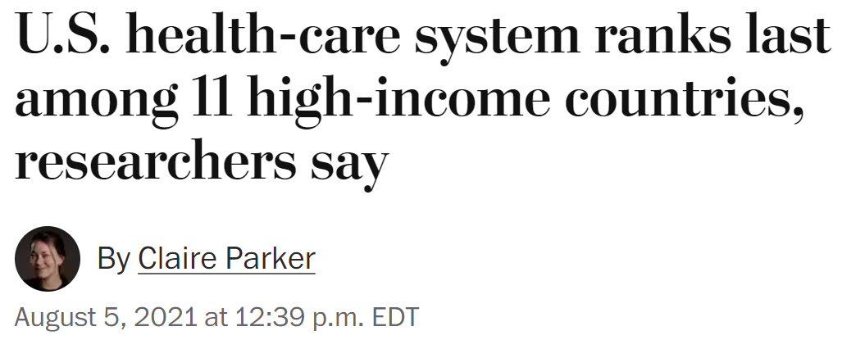
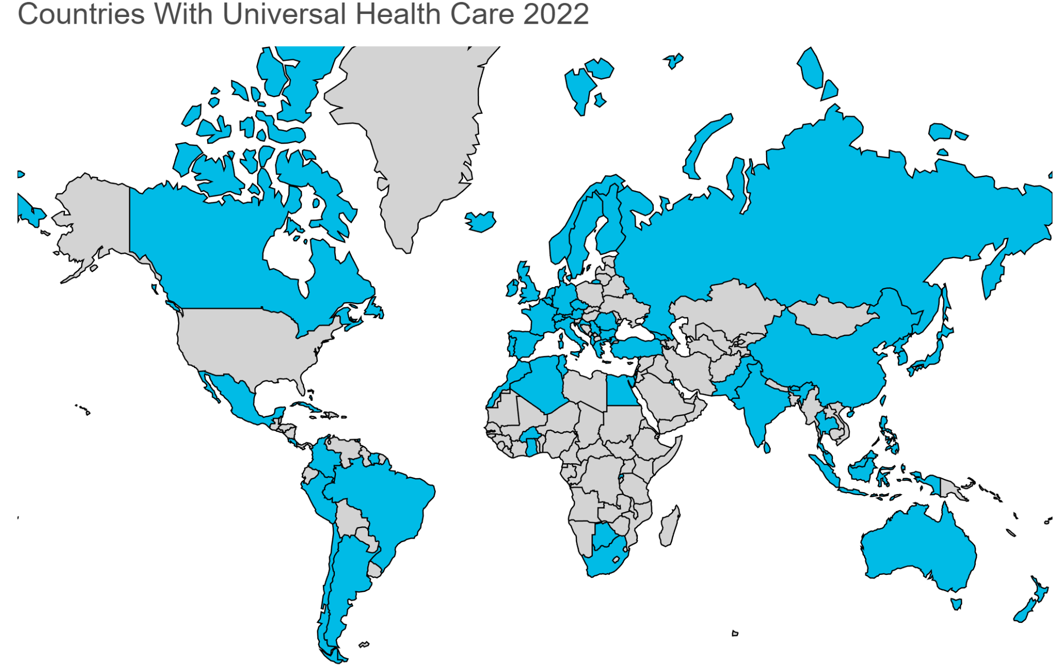
2. Mythbusting: Red-Scare or Anti-Socialism Fears
WHO: https://worldpopulationreview.com/country-rankings/countries-with-universal-healthcare
Study from Commonwealth Fund
Health Care Systems Measured Holistically
Access to Care
Care Process
Administrative Efficiency
Equity
Health Care Outcomes
(We Covered This Tuesday)
Notes:
So the first point we want to address, and really get it out of the way, is the silly critique that Medicare for All would make America a socialist, communist, totalitarian state where families have to wait in bread lines for hours on end.
As you heard in the fox news clip, the US is actually the odd one out when it comes to healthcare in other western or European nations. Every country offers universal healthcare in some form or another, whether it is full government-ran healthcare or publicly financing the private delivery of healthcare, or just heavily regulating a private industry.
Single Payer would just be government-sponsored insurance that funds privately owned doctors’ offices and hospitals.
And, as covered on Tuesday, their healthcare systems are way better than ours.

Slide 30
2. Mythbusting: “We Cannot Afford Medicare for All”
A recent study by Yale epidemiologists found that Medicare for All would save around 68,000 lives a year while reducing U.S. health care spending by around 13%, or $450 billion a year. (DOI: https://doi.org/10.1016/S0140-6736(19)33019-3)
The biggest sources of savings are simplified billing, removing the excessive health insurance profit margin, and lower drug costs.
Nearly every other study done on single-payer shows it saves money, while providing universal coverage
As covered on Tuesday… We cannot afford our current System!
US Health Care Spending per Capita!
Notes:
Again mentioned in the Fox News Clip, the most common critique and gaslighting on this topic is we cannot afford Medicare For All. This is, and I cannot stress this enough, a bold-faced lie.
Seriously there are 23 studies that I have read that ALL estimate Medicare For All would save our country money WHILE living up to the promises of the program, including full medical, dental, mental health, vision and hearing, and long-term health for all residents in this country.
This more recent study from Yale indicates that Medicare For All would save 68,000 lives per year while reducing health care spending by around 13%, or $450 billion a year.
These savings largely come from simplified billing, removing the high administrative overhead and profits of the health insurance system, and lowering drug costs.

Slide 31
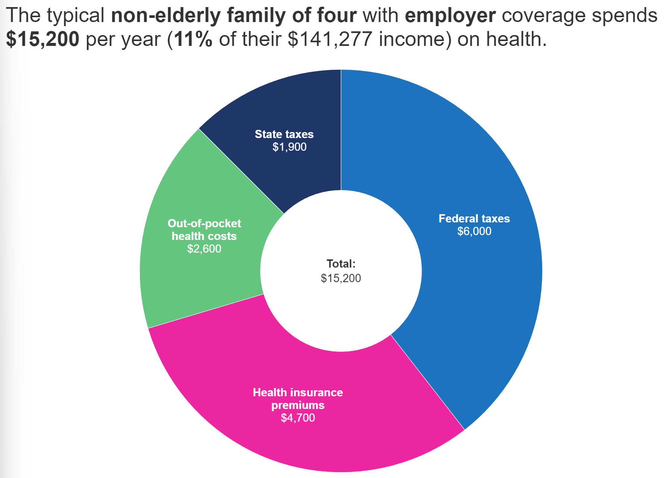
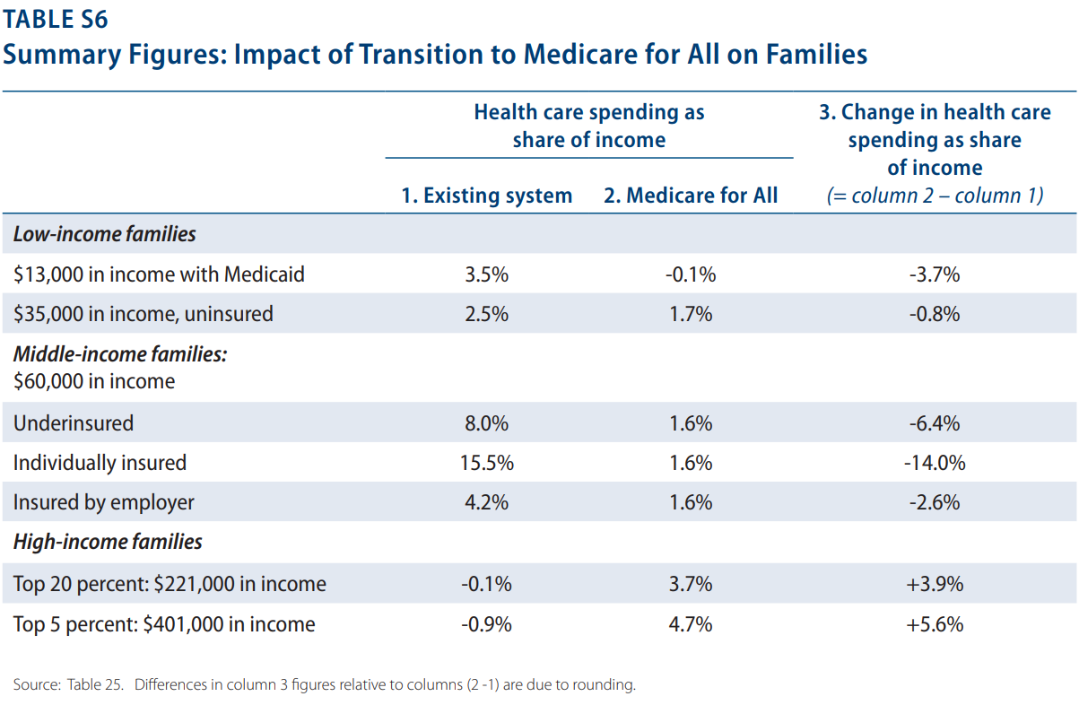
2. Mythbusting: “Americans Won’t Support a Plan That Increases Taxes”
Comparing Individual Payments (Current System in 2019 vs. Med-4-All)
Source: Health System Tracker (Peterson-KFF) & Economic Analysis of Medicare for All (PERI 2018)
Notes:
MAKE SURE TO ADD TAX PLAN; STARTING AT 29,000 income
Just to add additional context and data to back up mine and Bernie’s argument here, since we’re basically colleagues, I wanted to add this slide.
The image is left actually breaks down what an average family of four pays in total on Healthcare, including their premiums, out-of-pocket costs, and the portion of their State and Federal taxes that go towards health programs and health industry subsidies.
The table on the right is from a 2018 study that estimated how much less or more families would pay under Single Payer. Low income families and families on Medicaid save .8 to 3.7% of their income w/ the change to Med4All
Middle income families and individuals ($60,000) have the largest savings of 2.6 to 14% of their income.
Only the top 20% of income earners would be expected to pay more under Med4All, and this study did not estimate an inclusion of the Wall Street Transaction Tax either, so this may be lower than estimated.

Slide 32
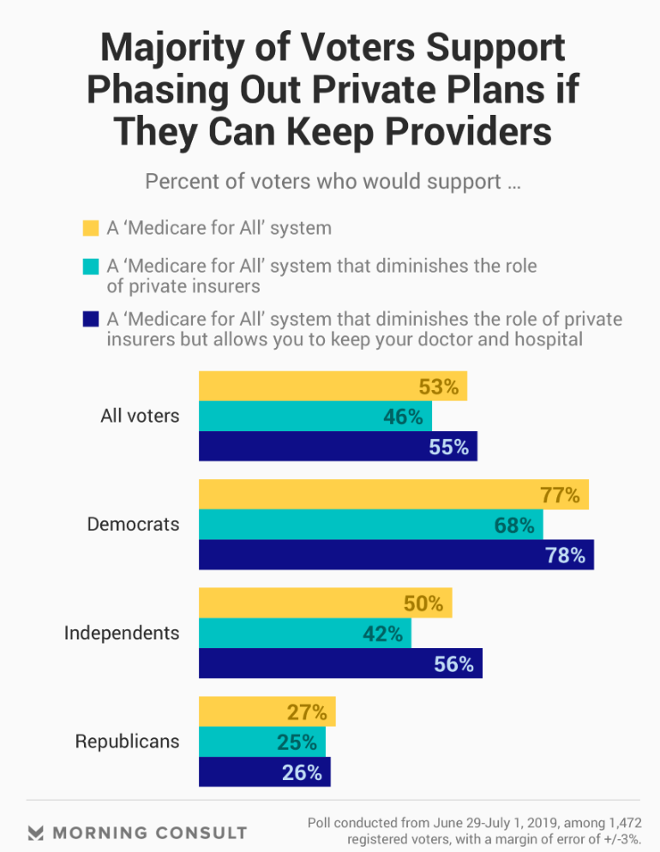
3. Mythbusting: “Americans Want Freedom of Choice w/ Insurance”
Reality Check: Americans HATE shopping for insurance. (Kaiser Family Foundation & Axios Reporting)
During any insurance programs annual enrollment period, most people stay with the status quo, even if there are better deals out there!
<1 in 10 seniors voluntarily switch from one private Medicare Advantage Plan to another
Same for private prescription plans
Most employers usually don’t change insurance plans, mainly out of fear of angering their workers - especially during election years
<half of the people on the ACA Marketplace have ever re-enrolled in a new plan
Medicaid recipients often have no say when it comes to the private plans they receive
The choice Americans want, is the choice of their preferred doctor & hospital!
Notes:
Another argument made is that Americans want FREEDOM, they “supposedly” want the freedom to pick their own insurance and shop around like they are at a surplus grocery store with 583 different types of cereal.
This could not be farther from reality. Americans, according to the data, HATE shopping for Insurance, and rarely change their insurance plans once they have one, even if there is a better deal out there!
Fewer than 1 in 10 seniors change their Medicare Advantage or Prescription Drug Plans
Workers who get their health insurance through their employer DO NOT EVEN GET A SAY in their health insurance plans, and any change in insurance is largely controversial in companies, this is the same for Medicaid patients.
Even on the ACA Exchange markets, which are DESIGNED to be as transparent as possible with prices and benefits, so that people can trade one plan out for another every year… Still, less than half of people on the ACA have EVER re-enrolled in a new plan.
The truth is Americans want the freedom to see the doctor and go to the hospital that they want to go to, which is only guaranteed under Medicare For All

Slide 33
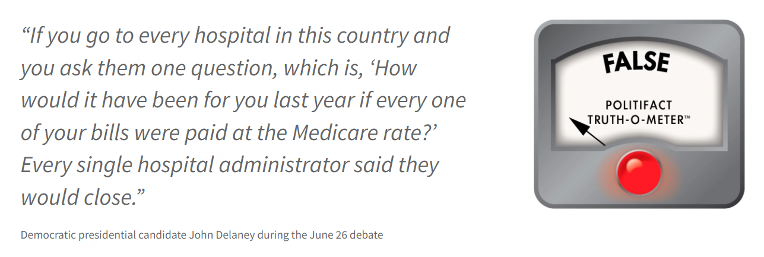
3. Mythbusting: “Hospitals will go Bankrupt”
Different hospitals would be paid differently
Hospitals serving mainly uninsured or underinsured patients would benefit from Medicare for all
Hospitals serving mainly privately insured patients might see revenues decline
The might comes from the current Medicare reimbursement rate for hospitals
However, the Medicare for All Bill doesn’t say hospitals would be paid at the current Medicare rates
The odds are low that the government would pay the current rate
Notes:
probably increase their revenue under the new system because they would no longer face the financial pressure of uncompensated care
Economists are quick to point out that the latter scenario isn’t necessarily bad. American health care spending is notoriously higher than that of other developed countries. Research suggests that hospitals, particularly those with lots of influence or market power, are among the key drivers of these high costs because they are able to negotiate much higher rates with insurers.
https://khn.org/news/delaneys-debate-claim-that-medicare-for-all-will-shutter-hospitals-goes-overboard/

Slide 34
3. Mythbusting: “Doctors Will Get Paid Less and Leave the US”
Doctors will actually get paid MORE under Med-4-All, according to the CBO
The Congressional Budget Office (CBO) is a non-partisan federal agency that works for the legislative branch and calculates all budgeting for new & existing laws
It predicts that in 2030, providers’ total outpatient revenues would be between 5% and 9% higher under Medicare for All than without reform, due to higher healthcare utilization, even if fee levels were to decline
Some scholars project even larger boosts to physician take-home pay!
They believe the CBO estimates understate practices’ savings from streamlined billing
Studies suggest that Med-4-All would free up roughly 5% of doctors’ work hours currently spent on billing
Allowing them to increase patient care, and increase per-physician revenue by between $39,816 and $157,412 annually
And as we covered Wednesday, Physician Panels can advise raising fee rates directly to Regional Directors, and have immediate action taken
Cai, C. How Would Medicare for All Affect Physician Revenue?. J GEN INTERN MED 37, 671–672 (2022). https://doi.org/10.1007/s11606-021-06979-z
Notes:
Value based care models also increase physicians payment
Can work in universal health care
Medicare for All is how it’s being paid for
Value-based care is how care is being delivered

Slide 35
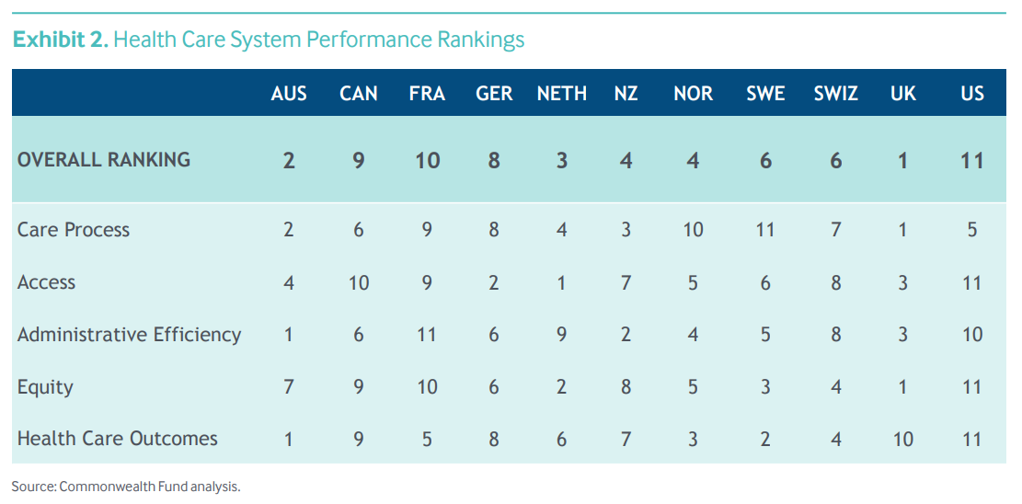
3. Mythbusting: “Socialized Healthcare Systems like the UK are Failing”
Notes:
Care process: prevention, safe care, coordination, and patient engagement
Access: affordability and timeliness

Slide 36
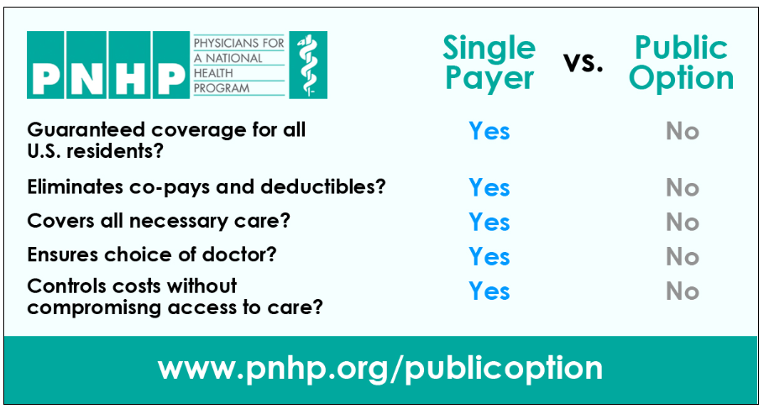
4. Mythbusting: “Why Can’t We Do a Public Option? Why one Universal Plan?”
Allow insurance companies to continue profiting off the sick
Would leave millions uninsured or underinsured
For-profit insurance company waste would continue
Some political theory here: “Any means-tested policy that is not universal, is absolutely going to be gutted by future legislative bodies or presidents. They will cut funding and make the policy weaker until it is unfavorable enough to get overturned”
Coverage under Medicare For All would be guaranteed and more comprehensive
Guarantee home access and community-based care
No more price gouging by pharmaceutical companies
Notes:
https://www.citizen.org/article/why-medicare-for-all-not-a-public-option-is-the-best-solution/
https://pnhp.org/why-the-public-option-is-not-a-real-solution-to-our-health-care-woes/

Slide 37
4. Mythbusting: “Why Can’t We Do a Public Option? Why one Universal Plan?”

Slide 38
5. Summary: Why Pass a Resolution for Medicare For All
We spend way more on healthcare and get far worse health outcomes
Our current system causes financial hardship, avoided care, and unnecessary death
Medicare For All would save money, save lives, and provide FULL health care coverage for everyone!
Most opposition to Med4All is fueled by private health interests & the pharmaceutical lobby, who profit off of price-gouging medications & denying coverage for Americans.
Many of the most common critiques of Medicare For All are easily disproved with facts
So much we could NOT even get to…
Healthcare provider burnout from billing & arguing with insurance companies
Distrust in healthcare providers, Diminished health literacy, & misinformation
Societal & economic impacts of a sickened population with little preventative care
Personal stories from people who fell threw the gaps of our health insurance system
Notes:
(SUMMARY: READ OFF SLIDE)

Slide 39
5. Summary: A Call to Action!
We ask that you support our resolution for the Kent City Council to endorse the Medicare For All Act of 2022 (S.4204); and declaring that access to quality affordable healthcare is a human right.
Thank you.
Notes:
(READ OFF SLIDE)

