Slide 1


Physicians for a National Health Program
Transformational Organizer Training
Chapter Building: Infrastructure & Vision
Trainers: Michael Massey, Andy Hyatt, Lori Clark
Remember to record the Zoom Call!!
Notes:
So Hi Everyone, thank you all for being here.
Today we’re going to be building upon the lessons we have learned from the previous trainings, mapping our our potential allied organizers and supporters and having one-on-ones with them, and now describe how you can build an effective PNHP or SNaHP Chapter.
This may feel like a bit of a departure from the previous trainings, since there’s going to be a lot more content packed into this one, so we will go ahead and record the presentation portions of this training and be sure to send out the slides when we follow up.

Slide 2
Introductions
If you haven’t already, please introduce yourself in the chat!
Name, Chapter & State
What you hope to learn from this training?
Favorite Book/TV Show/Movie right now?
Introduce myself & what I hope to impart with this training
Notes:
If you haven’t already done so, please introduce yourself in the chat!
I have introduced myself at previous trainings, but I am a second year medical student at Northeast Ohio Medical University here in Ohio. Two years ago, I founded a SNaHP chapter at my medical school along with several classmates and have served as the President up until our recent leadership transition.
I have been pretty thankful and proud for all we have been able to accomplish in our chapter, and I will be sharing some of our achievements throughout the presentation, but I guess what I am hoping to share with all of you, is how you can build up your own chapter to become a powerhouse of your community.

Slide 3
Agenda
8:05 - Introductions, Overview of the 8 stages to create a effective chapter, cover
steps 1 through 3
8:25 - 1st Breakout Rooms: Debrief from your one-on-ones + vision for your chapter
8:40 - Cover Steps 4 through 7
9:05 - 2nd Breakout Rooms
9:20 - Cover Step 8, Explain Homework, Evaluations
Notes:
And this is a brief overview of the Agenda for today, just to let you all know we will have two breakout rooms today and have another homework assignment due for the next session

Slide 4
But first, why are chapters important for PNHP & SNaHP?
Notes:
But first, and this might be a bit simplistic, but I have a question for you all, you can either unmute or type in chat, but why are chapters important for our movement, as opposed to having everything come from the National Team?
Grassroots effort, We could not get anything done without you
Bring more people into our movement with local organizers
More leadership opportunities, incentive for others to join
Also can bring a tangible benefit to your local community
Build an actual community of like-minded students or physicians
In short, without dozens to hundreds of active chapters, all building power and changing minds, we won’t get Medicare for All

Slide 5
8 Stages to Building a Strong SNaHP/PNHP Chapter
Establish a Sense of Urgency
Creating the Guiding Coalition
Developing a Vision and Strategy
Communicating the Change Vision
Empowering Broad-Based Action
Generating Short-Term Wins
Consolidating Gains and Producing More Change
Anchoring New Approaches in the Culture
Encompasses our ‘Mapping’ and ‘One-on-One’ Training
Based off of the 8 Stage Process of Creating Major Change (Kotter, Harvard Global Health)
Notes:
So I think you all signed up for this training because you are either starting a chapter or in a position of leadership, and hoping to find out how you can make you and your team more effective in advocating for single payer. Since I did not have a background in labor organizing before I started my SNaHP chapter, I used my background in global health to guide our chapter’s formation, so this training is based off of a Harvard professor’s guide to creating long-lasting global health projects, which I think is pretty similar to the task of creating a SNaHP or PNHP chapter.
The question being, how do you build the foundation for a chapter to last years after you have moved on? Well, if you follow these 8 steps in order, you’ll be well on your way to crafting a successful chapter.
*CLICK* Step 1 is Establish a Sense of Urgency, or convince others of the importance of single payer
*CLICK* Step 2 is creating a Guiding Coalition of influential, motivated allies to support your cause
*CLICK* 3 is to develop a vision & strategy with that guiding coalition
*CLICK* 4 is to effectively communicate that vision and strategy to your broad base of members and others
*CLICK* With that effective messaging, you’ll want to inspire others to take initiative on projects
*CLICK* And this broad based action will then generate short term wins for your chapter. These short term wins will provide a lot of momentum for your group and encourage others to join
*CLICK* While these wins will be great for sparks of momentum, your leadership team will want to stay focused on your long term goals and incorporate the momentum you gain into more impactful advocacy work going forward
*CLICK* All while you do these steps, you’ll want to continuously reflect and learn from your work. Ask yourself what went well or what needs adapting, and make sure the leadership team who takes over after you is knowledgeable on how to improve upon what you built.
So I know this all seems a little abstract at the moment, but don’t worry we will go into each of these with a bit more detail. I will say that if you look at the first 3 points, “Establishing a Sense of Urgency”. “Creating a Guiding Coalition”, and “Developing a Vision & Strategy”...
*CLICK* You pretty much did those with your One on One Conversations and Mapping out your allies and supporters
Before we go into breakout rooms about your one on ones, I did want to share more about these first 3 points from a chapter-building perspective.

Slide 6
Establish a Sense of Urgency
*** Make uninsurance & underinsurance the #1 issue discussed at your institution
Methods:
One-on-ones
Patient experiences
Class material
Host educational events
  Lunch lecture series
  Panel discussions/ guest speakers/ debates
Circulate on social media
Notes:
I think it makes sense that the first step in getting people to join your chapter, is to tell them why single payer is needed. While it may be obvious to all of us on the call today, some medical students and physicians may have a privileged background or are aloof to the plight of most americans. So in addition to the one on one conversations you have with people, where you share some personal or patient experiences, your chapter should strive to educate more and more members of your institution through a variety of events on the gravity of the situation, and that we have a solution with single payer. In my first year, I made a habit of constantly texting my whole class about issues with insurance companies. I had a back-catalog of news stories about overpriced medications or people avoiding the treatment we were learning about, and I would share that with all of my class to constantly reinforce how prevalent this problem is.
Many medical schools already have lectures about healthcare disparities among marginalized communities, but I personally found that this same acknowledgement and education was not extended to economically disenfranchised Americans, and when 4 out of 10 Americans hold medical debt in the US, your chapter should strive to make this point of conversation the #1 issue discussed at your institution, and I want to clarify what I mean by that.
Healthcare costs already disproportionately affect people of color and members of the LGBTQ+ community, so these issues are linked; however liberal higher education institutions are very rarely open to discussing economic-based reform. My ask to all of you, is to add that class perspective to health care disparities.
So these event ideas listed here are hyperlinked to YouTube videos of the events we hosted at our chapter, if you want an idea of how that could look.

Slide 7
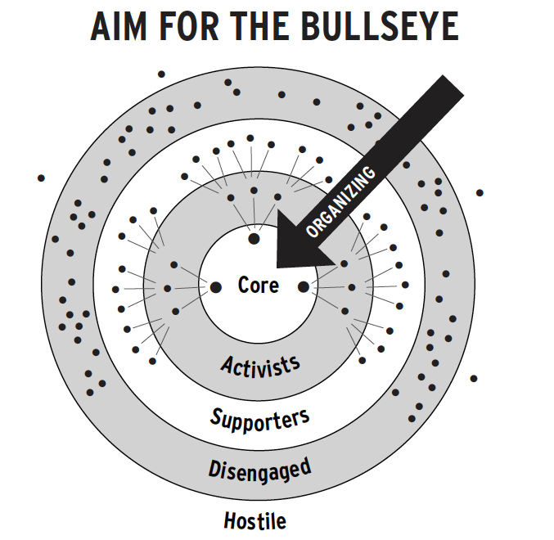
2. Creating the Guiding Coalition
*** Coalition must include people in power or who have influence
Leadership Team
Supportive Faculty/ Colleagues
Allied Organizations
Reflect on your Mapping Homework: Who or what groups of people will join your leadership team or guiding coalition?
Notes:
After you make a call to action at your university, you want to create a guiding coalition with people who can help your chapter grow.
So, I have another question for you all on the slide if you can type it in the chat or unmute, and it is about your mapping homework from the first session.
Who or what groups of people can you reach out to to join your leadership team, which would be those Core organizers in the center of the bullseye?, and
Who or what groups of people can you call upon to support your chapter or become occasional activists?
Like-minded students or physicians
People already involved in advocacy work
Natural Leaders/ Charismatic/ Dedicated workers
Try to get leaders from multiple friend groups, so they can organize their own friends.
What about supportive allies?
Faculty, departments? → We will get into that on the next slide

Slide 8
2 (Continued) Example Chapter Map
Total Universe ~250 people
Pop Health/ Policy Instructors
Faculty Unions
Primary Care, FM, Peds faculty
AMA/ State Med Soc.
Social Justice Groups
MD/MPH Students
COM Dean, other Department Chairs
Student Services
FACULTY
STUDENTS
Student Gov’t
Gov’t Relations
Team
Social Justice or MPH Faculty
Other Supportive Faculty
Other Health Professional Students
Marketing & Communication Team
Undergraduate Students
Potential Faculty Advisor**
Supportive Departments**
Graduate Student Unions
Notes:
On the Mapping your relationships training, we had an example map for a hospital setting, so this time I wanted to highlight one for a medical school. This outlines who could be in your guiding coalition, whether they are a student or a faculty member.
On the students side, it is an easy start to find students interested in advocacy by approaching students who are already members of the other medical society chapters at your school or other student government or social justice groups. Students who have or are pursuing their Master’s in Public Health are probably supportive and have additional education on health policy to support your chapter.
If you are in medical school, it is going to be the easiest to pull in other medical students, but don’t shy away from trying to reach out to other health professional students, undergrad students, or other graduate students.
Since Andy, our resident Union Organizer, is on the call. I’d be remiss if I did not mention that local graduate student or faculty unions would also be great allies.
On the Faculty side, one of the first steps of starting a student organization is finding a faculty advisor. The highest density of physicians at your school who would support single payer are going to be docs that are a part of the social justice, population health, or policy educational sessions of your curriculum, or are in specialties that interface with the uninsured the most, like Family Medicine, Psychiatry, Pediatrics, or other primary care specialties.
There are a few departments of your university that can really help your chapter flourish. Obviously your university’s Student Services, or the department that oversees student organizations, is your best resource to understand how to plan events, order food, run fundraisers, and figure out technical issues with your school’s software for student organizations. I have a habit of going into seeing one of the directors of our student services department at least once a month to ask questions about our chapter, and honestly it's just a tradition at this point.
The Government Relations Department of your school, since every school has a lobbyist team, can help run educational sessions on how to talk with legislators, and the marketing and communications department can help set up your social media pages and help your team publish Op-Eds, since they have connections with people in media!

Slide 9
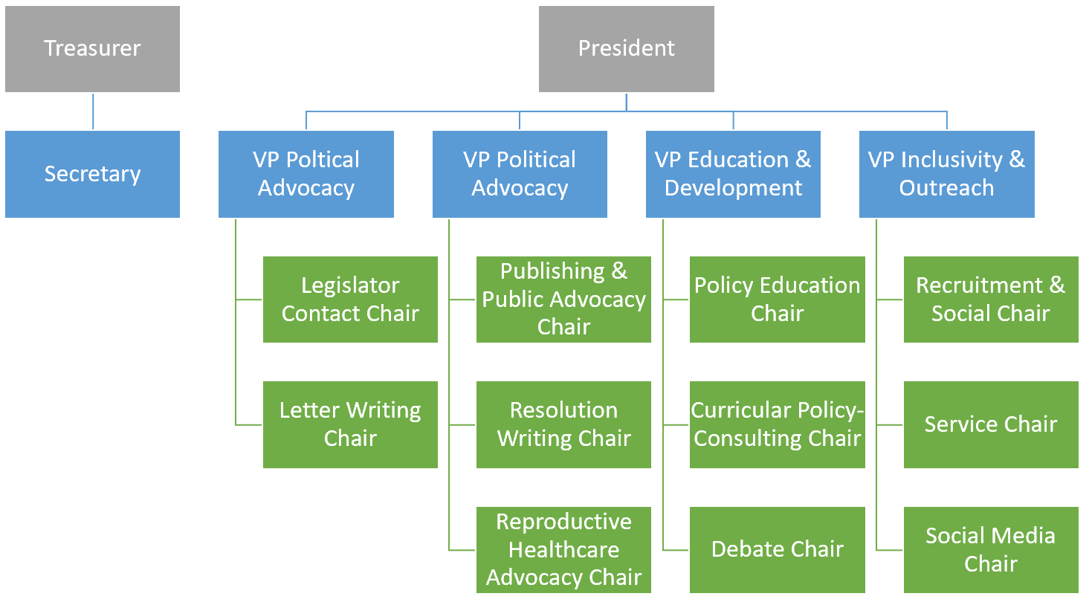
2 (Continued). Structure of your leadership team?
3 Tiers of Leadership
- Executive Board
-- Chair Positions
--- Committees
Examples of Committees
- Political Advocacy
- Education & Outreach
- Reproductive Advocacy
Notes:
I wanted to provide some additional advice on how you could structure your leadership team. This is our Chapter’s leadership structure. This is by no means a requirement to replicate.
The main advice I wanted to give was to create 3-Tiers of leadership positions, with the Executive Board (in the gray and blue) at the top, The VPs are basically Co-Presidents that control a separate wing of the organization and oversee or work with their own Chair positions.
The Chairs are generally responsible for one specific type of event. Medical School is busy so giving each Chair a concrete task to complete will help keep the scope of your chapter large, while everyone does an achievable amount of work.
Then any member or leader can join a committee. Ours are listed on the left hand side. This helps cut down on how many emails we have to send out to the entire organization. Some people are not comfortable with political activism or care about healthcare policy, so they can still join a committee that mainly works on campus projects, like service work or fundraising. I’d recommend having no more than three committees.

Slide 10
2 (Continued). Benefits of a 3-Tiered Leadership Model
1
2
3
4
1st Week of Classes
From Elections to Summer
Middle of Spring (March)
Right after (1st) Involvement Fair; Early Fall
Outgoing Exec Board work w/ the incoming Exec Board to facilitate a smooth transition of power and momentum!
The Chairs stay on over the summer until the next application cycle (fall)
Send out informational email to all students with the COMMITTEE SIGN UP FORM
The earlier you start before other orgs, the better
Hold elections for your Executive Board
Early enough so STEP 1 is still 2+ months away
Send out applications for Chair Positions
So new students get a leadership position!
Notes:
Another benefit of the 3-tiered leadership model is allowing students to get involved as early as possible and ensure some sustainability/momentum as leaders transition in and out at different times.
A good strategy would be to allow students to sign on to committees as soon as they walk in the door, because if you start your group’s projects before any other student organization introduces themselves, you’ll get more active members!
Then after the formal Involvement Fair, that I hope every school has?, you’ll want to quickly have students to apply for the Chair positions, again, before other student organizations have their “Informational Meeting”. Giving first year medical/dental/pharmacy/graduate studies students a leadership position at the start of the year will help draw a lot of engagement
And then you can host elections for new executive board positions in the middle of Spring after everyone has worked together long enough, and that gives enough time for the new leaders to be onboarded into the role from the outgoing executive board.

Slide 11
3. Developing a Vision & Strategy
***A bold promise, what will your chapter do?
Vision for your chapter
  What do you want your chapter to accomplish in the next year? Five years?
Vision for your members
  How will your members benefit from participating?
Vision for yourself
  What will you gain from this? How will you carry this work forward?
Notes:
So once you’ve crafted your guiding coalition, you’ll want to collaborate on a shared vision & strategy for your chapter. It’s important to emphasize that your “Vision” should basically be a promise of what you will do in the next year or five years.
This might have a different answer for each of you. When I started my chapter, I knew I wanted it to be sustainable for years after I graduated, which the jury is still out on, but at least the time I was here, I wanted our student organization to be the most productive and noteworthy organization on campus. I wanted us to make a tangible difference on the community, while making the argument for universal healthcare to as large of an audience as possible. I wanted to make Medicare For All the normative position among my classmates and faculty.
Now to do that, you also have to have a promised vision for students or colleagues you are trying to recruit. After all, what are you going to say in the recruitment emails or texts you send to avoid getting immediately left on read? Even when people agree on single payer, many people, especially young people are cynical about politics, so it is up to you to inspire them, and convince them we will get single payer when we organize. On top of that, you want to outline how participating in your chapter can directly benefit them. This is where those One-on-Ones can come into play to identify an individual’s self interest, but on a broader messaging front, I think highlighting that students can and will boost their resumes by joining your org will capture some students, along with highlighting the fact that advocacy skill are going to be sought after for any specialty a student is considering applying for.
And lastly, it is easier to engage with this work when you reflect upon what you want to achieve, while appreciating the small wins along the way. With that, I will turn it over to Andy to explain the first breakout rooms.

Slide 12
Breakout Rooms: 15 Minutes, 3 facilitated groups
1) Debrief from your homework assignment - the one-on-one(s).
2) How did the meeting go? What went well? What would you do differently?
3) What did you learn about the person?
4) Why do they care about single payer?
5) What else could have been asked?
6) If they agreed to take action, what steps did they agree to and what follow up did you commit to?
**7) What is your vision for your SNaHP/PNHP chapter? How will you achieve that vision?
**Have one person take notes and report back!

Slide 13
Breakout Room Debrief - 2 Minutes per group
How did your discussions go?
If you did your one on one, what is your next step?
If you did not do your one on one, what kept you from talking to someone?
What is your vision for your SNaHP/PNHP chapter, and how will you achieve it?

Slide 14
4. Communicating the Change Vision
*** Use every possible vehicle of communication to share your vision and strategy
*** Repetition & Redundancy are key:
Members need to see the leaders model the desired behavior/end-goals
GOOD BAD
~Frequent Meetings w/ everyone ~Occasional leadership (only) meetings
Consistent Messaging→ Institution Inconsistent Messaging→ only members
Consistent Offers to Join Sticking with first few people
Google Drive Organized & Shared Messy Google Drive, withheld access
Calendar Invites Email with Zoom Link (Event Details)
Hard-Working Leaders Lazy or Overly Committed Leaders
Detailed Agendas sent before Meeting Meeting with no detailed agenda
Notes:
Alright and we’re back, and we’re onto Step 4: Communicating the Change Vision. [[ANYTHING SHARED FROM DEBRIEF ON STRATEGY??]]
As an aside, I did promise Lori and Andy I would limit the amount of text I have on each of my slides, and I have to say I failed on this one.
To recap though, you’ve made a call to action, assembled a team, and generated a vision and strategy going forward with that team… Now how do you follow through on that vision and bring in new members. *CLICK* If you think back to the Organizer talk from Andy, your goal is to bring everyone in your network at least one ring closer to the bullseye, so how do you make tepid supporters into occasional activists? Or make activists into Organizers to replace you? Well in short, your chapter needs to get organized.
*CLICK-disappear*
According to this change model, repetition and redundancy are key to sharing your message with your members or broader audience. Generally, at the top leadership positions of your chapter, you will most likely be the hardest working person in the group, so if you want other people to put any effort in, you’ll want to lead by example and model your own expectations for other members or future leaders.
So there a few Do’s and Don’ts I wanted to share regarding your group communication. You’ll notice most of these points emphasize reaching out to everyone who’s at least a member, if not the entire institution, and really that goes into the idea that you should always be marketing your team and trying to bring more people in, so that being said…
- It’s good to have regular chapter meetings every month, 6 weeks, or two months as the longest duration in between meetings, any longer than that and you’ll be hard-pressed to gain any momentum
- It’s good to be consistent in your messaging, particular when advertising your vision
- Always be willing top recruit someone if they ask or talk about your team’s work, even if it’s for just one project or event
- You also need to be really organized with your school’s google drive, so members have access to your resources or meeting minutes
- This next one was a big one for me, I have missed nearly every event I have signed up for if I did not receive a calendar invite for it. So I would recommend creating an Outlook group for all your members and routinely send them calendar invites for all of your meetings and events.
- Like I said, the main chapter leaders will set the tone for what involvement is expected (or possible!) for members
- And make sure the meetings you actually have are effective, which Lori will lead a training on next session, but part of that involves sending out an agenda to everyone beforehand so they know what will be discussed

Slide 15
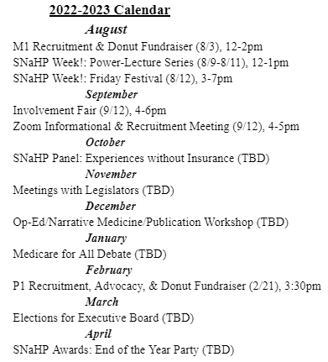
Create a Year-Long Calendar to Aim For→
What we actually did
August: All listed events
September: All listed events + Lobby Kent City Council
October: All listed events + Passed Resolution in Kent! + Began state medical society resolution
November: Updated resources for Kent Health Dept. + Attended PNHP/SNaHP Annual Meeting
December: Updated Resources for Kent Health Dept. + Lobby Akron City Council + Submitted resolution
January: Debate + MSS Resolution Meeting + Akron CIty Lobbying
February: Pharmacy Recruitment + M2 Advocacy Class + E-Board Applications
Notes:
Another highly recommended way to communicate your organization’s vision to your broader membership would be creating a year-long calendar in the summer months ahead of the next academic year, and using that calendar in your recruitment materials. You can plot out anticipated events that you’ll be hosting and when leadership selections will occur. That way, students have a better understanding of what an advocacy org might do, if they have never been in one before.
This was our calendar that we made for this past year, and what I wanted to emphasize is that while your calendar can guide your chapter’s direction for the year… *CLICK* it doesn’t have to be your holy doctrine, we adapted to new opportunities and cut things out when exams were too much of a priority.

Slide 16
5. Empowering Broad-Based Action
***Culture of empowering all leaders & members to take initiative and risks; remove those risks for future members
QUESTION: What are some good leadership qualities or methods of empowering others to lead?
Notes:
Okay now we’re on to step 5, after fully sharing your vision and plans for the chapter, how do you then empower your other leaders and members to take on their own projects?
I actually ran out of time making this presentation, so I wanted to defer this question to you all. What leadership qualities or practices are useful in empowering others to lead?
- Humility/Humble → Gives others all the credit, and actively shares their wins
- Offer others opportunities to lead (facilitate meetings, lead projects, or even as simple as having others send out the group email or text)
- Encouraging, offers help
- Follows up
- Friendly, keeps it fun! → Celebrate wins, get drinks after events
- Provide multiple levels of opportunities to get involved (One Testimony/signing a petition vs. Leading a presentation/Debate)
- Keeps true to their moral conviction “The patient is why I’m here”

Slide 17
6. Generating Short-Term Wins
7. Consolidating Gains and Producing More Change
***A clear path to quick wins/rewards encourages others
***Must go beyond quick wins, build on your momentum towards your long term goal
4 Case Reports from SNaHP at NEOMED
Political Advocacy - City Resolution
Base-Building - Medical Society Resolution
Base Building - Reproductive Advocacy
Education - Events → Curriculum
Notes:
For steps 6 & 7, I wanted to combine them into 4 separate case reports from our chapter to do two things
Be a bit more direct in outlining how these two steps are directly related
Share some ideas for what you can do in your chapter
These case reports will start with a short-term objective or goal that can be easily marketed for less committed members to participate in, and then how we expanded off of that success to build even more power.
And to categorize these case reports, I separated them into what I believe should be the three pillars of any PNHP/SNaHP chapters long term strategy.

Slide 18
Case Report #1: Political Advocacy - City Resolutions
City/County Resolution
Health Dept. Projects Connection to Akron & Lori School Recognition
Health Fair Website Resources Med Debt Relief Gov’t Relations Recruitment
2 More City/County Resolutions (Akron & Summit County)
Notes:
To get your chapter engaged in Political Activism, my number one piece of advice is to NOT sleep on local politics. The easiest and best thing your chapter can do, from our experience, is passing a resolution endorsing Medicare for All (or single payer) in your local city council or county council. I included a link for “city resolutions” that takes you to the site to get yourself started. We worked with Public Citizen who offered us guidance on how to pass it in Kent, OH.
While this did involve 2-3 months of a small team of 1-3 students attending every council meeting, it only required 3 consecutive meetings of testimony and a larger coalition of students showing their support.
We could not have predicted how valuable this resolution would have been. We basically became friends with the Health Department Chair from Kent and have done service projects with them. This effort is what actually connected our chapter with the National Team and with Lori, and we got a boost in recruitment and energy from our school.
What is even more important, is local officials have a lot of connections- we were connected with an Akron city Councilwoman from the Kent City Council, and it was through our partnership with her, that we were able to pass a city ordinance that is projected to clear over $50 million of medical debt for Akron, OH residents. After our work with the medical debt relief project, we plan to follow up with two more single payer resolutions in Akron and Summit County.

Slide 19
Case Report #2: Base-Building - OSMA Resolution (guide)
2 Resolution Ideas to OSMA (Counts as Publication if passed)
Easy work→Most authors on ours Connection to other med schools
Made M1s the Primary Author Collab. + encouraged SNaHP Chapter formation
1→ HoD, making connections Formed SNaHP Ohio (6/7 Ohio Med Schools)
Future Leadership team ready to do again next year
Notes:
While resolutions to medical societies are a much slower and less-likely to be successful resolution campaign, we all still need to constantly pressure the AMA and their state chapters on the issue of single payer. To get them to actually adopt a pro-single payer stance, we need to network with any and all potential allies within these societies and build power from there.
Similar to city resolutions, medical society resolutions can pull in many students to contribute a small amount of work while relying on a core team of 2-3 students to carry it to the finish line. This works by having as many students become a co-author of your resolution by writing as little as one WHEREAS statement. As a recruitment tool, you can let students know they are eligible to list any passed resolutions (either by the MSS or full HoD) as an “other” publication on their ERAS application.
From this process, we were able to connect with medical students at other Ohio Medical students who care about single payer and were either already in a SNaHP chapter there, or we encouraged them to create one. From there, we created a state SNaHP Ohio chapter, a few of our leaders are actually on this call.
We also are networking with supportive physicians within the OSMA so we can one day fully get the OSMA to support single payer.

Slide 20
Case Report #3: Base-Building - Reproductive Advocacy
Through connections → Invited to do Instagram Live with Repro Rights group
Invited to support Ohio Ballot Initiative Process
Organize students at NEOMED Organize students in SNaHP Ohio
New recruits, more energy Officially partnering & fundraising for initiative
Collecting Signatures, making more connections
Notes:
For this one, I feel like I need to re-emphasize that we all live & study in Ohio, where Reproductive Rights are under attack. While I’d normally advise to remain a single-issue organization, and we still do while conversing with legislators, we all agreed to support a ballot initiative that is underway here in Ohio that would protect abortion and contraceptive healthcare under the Ohio constitution through a amendment.
When we announced that we were going to help organize signature collectors and fundraise for the campaign, we got a few more people to sign up and got connected with even more organizations in the state.
What I think is important to highlight here, is this all started because we had passed the resolution in Kent, and then met a PNHP doctor and reproductive rights activist based out of Cincinnati at the last PNHP annual meeting. She recommended we have an instagram live conversation between our group and theirs, the Ohio Physicians for Reproductive Rights, and everything else came from that quick conversation.

Slide 21
Case Report #4: Education - Events → Curriculum
Wanted to make healthcare access #1 discussed issue at our school
Hosted Educational Events Our F.A. is a Course Director Kent/Akron Advocacy
Lecture series, Panel, Debates Suggested 2 classes → Add to curriculum
(May add to
curriculum) Advocacy Skills + Uninsurance: A Public Health Crisis
Now to be repeated next year! (w/ more ideas)
Notes:
Lastly, I want to focus on Education. Like I said at the beginning of this presentation, I wanted our chapter to make healthcare access the #1 discussed issue at our school. So we hosted a free lunch lecture series on our comprehensive argument for single payer, a panel discussion of physicians and patients on providing or receiving medical care when insurance was an issue, and a debate on healthcare reform.
Like I said before, as well, I was frustrated that uninsurance and underinsurance, as it pertained to disparities or issues in healthcare, was completely absent from our curriculum. So I actually looked up the LCME accreditation requirements, and found that health policy, economics, and social determinants in health disparities were either required or recommended to be in the medical school curriculum.
Our faculty advisor for our chapter is luckily the course director for the class that any of these type of lectures would fit into, and so when I recommended that these classes be taught, he agreed with me on the one condition that WE run the classes. I think it really benefited us that we had already passed a resolution in Kent and ran all of these other events beforehand so he knew we were capable of doing so.
This past year, our members ran a lecture and panel on physician-advocacy skills in person to M2 students and other students prepared a recorded lecture on Uninsurance being a Public Health Crisis for M1 students. The plan is to include these classes year after year now, and we’ve had conversations about adding other panels or education to our curriculum.

Slide 22
Breakout Rooms: 15 Minutes, 3 facilitated groups
1) Debrief from chapter-building advice.
2) What infrastructure will you build to keep the entire chapter engaged and up to date with the team’s work?
3) How will you guide your leaders and members to take initiative on their own projects?
4) What short-term wins can you pursue to then build a stronger chapter?
**Have one person take notes and report back!

Slide 23
Breakout Room Debrief - 2 Minutes per group
Reflections on chapter-building advice
What infrastructure will you build to keep the entire chapter engaged and up to date with the team’s work?
How will you guide your leaders and members to take initiative on their own projects?
What short-term wins can you pursue to then build a stronger chapter?

Slide 24
8. Anchoring New Approaches in the Culture
***Bring all prev. points^ together, and onboard new leaders into this system of continual growth
Commit ample time throughout the year to training your replacements
Identify your desired replacements and tell them to apply
Discuss steps 1 through 3 with them, and how THEY can…
  Establish a Sense of Urgency
  Form a Guiding Coalition
  Develop a Vision & Strategy
Notes:
So if you do steps 1 through 7 while you are in leadership, your chapter will be incredibly active while you are there; however, it may completely fall apart if you do not train the new leaders to become organizers themselves.
This will be out of your control regardless, but you can and should take steps to make sure the new leadership team feels comfortable to lead your org, and acknowledges that they should focus on passing down the chapter successfully too.
In my view, this can be achieved by identifying leaders early and often throughout the year and telling them that you would like them to replace you.
When you do select your new leadership team, it may be helpful to walk them through this exact step by step guide so they know all the ins and outs of being a chapter organizer.

Slide 25
In Summary… Follow these 8 Steps for Chapter-Building
Establish a Sense of Urgency
Creating the Guiding Coalition
Developing a Vision and Strategy
Communicating the Change Vision
Empowering Broad-Based Action
Generating Short-Term Wins
Consolidating Gains and Producing More Change
Anchoring New Approaches in the Culture
Encompasses our ‘Mapping’ and ‘One-on-One’ Training
Notes:
In summary, I hope this training was able to explain how you can use these 8 steps to make an effective and long-lasting chapter.

Slide 26
Homework:
Identify your team leaders & leadership structure, any changes following this training?
Communicate/discuss your chapter’s vision with your leadership team
Create a list of potential events, campaigns, long-term goals for your chapter.
Create a year-long Calendar for your chapter.
Create the necessary infrastructure for your chapter: Outlook Email Group, Google Drive (chapter gmail), Group Chat, Social Media
Notes:
We do have homework for you all, and it’s kind of a grab bag of anything that was shared today, so all of this may be too much work for the next two weeks, feel free to pick and choose what you think is the most important.
We will send you the prompts in our follow up email, but basically we’re asking you to
reflect on how your leadership team is structured or could be restructured to incentivize growth.
Discuss your chapter’s vision with your guiding coalition, including your long term goals
Create a calendar for next year with your anticipated events and leadership application cycle
& Make sure your infrastructure is primed for organized, timely communication.

Slide 27
Thank you! See you on April 19th
Feedback:
Notes:
Thank you all so much for attending tonight, we will see you back on the 19th!
(FEEDBACK if there is time):
Went well:
You Learned:
Could be improved upon:

